Slide 1

6LoWPAN
The Wireless Sensor Networks of the new generation
Little Fool(付康为)

Slide 2
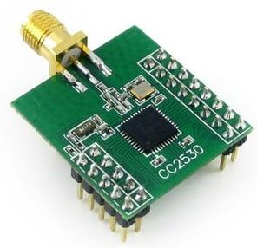
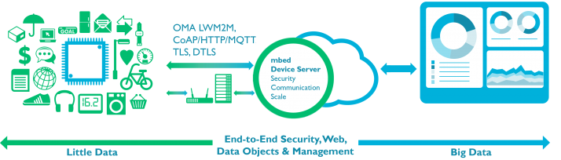
What is 6LoWPAN?
6LoWPAN is a kind of Wireless LAN(Local Area Network).
It is based on IPv6 and IEEE 802.15.4.
It can be used by Low-Power embedded equipments.
6LoWPAN will be promising in IOT field.
ANIMATIONS
15%
AWESOME WORK
⬧

Slide 3
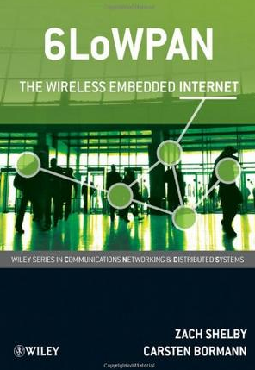
6LoWPAN Framework
Application Layer
Transport Layer
Network Layer
Data Link Layer
Physical Layer
6LoWPAN Framework
TCP/IP Framework
from “6LoWPAN: The Wireless Embedded Internet”

Slide 4
6LoWPAN Application
Every node is used for the monitor of the environment.
Border Router is used for the connection between Ethernet and 6LoWPAN WSN.
Users have access to the nodes by their smart phone or PC.
ANIMATIONS
15%
AWESOME WORK
⬧

Slide 5
6LoWPAN vs ZigBee
Similarities
Based on IEEE 802.15.4
Supported by embedded devices
They can both form wireless sensor network.
ANIMATIONS
15%
AWESOME WORK
Differences
zigbee needs routers to transfer the data form end devices.
In 6LoWPAN, every node plays a role as a router.
6LoWPAN has a great compatibility with Internet
⬧
ZigBee

Slide 6
Border Router
Transfer IPv6 packets between Ethernet and 6LoWPAN.
In Ethernet, IPv6 packets are based on IEEE 802.3.
In 6LoWPAN WSN, they're based on IEEE 802.15.4.
ANIMATIONS
15%
AWESOME WORK
Ethernet
6LoWPAN
⬧

Slide 7
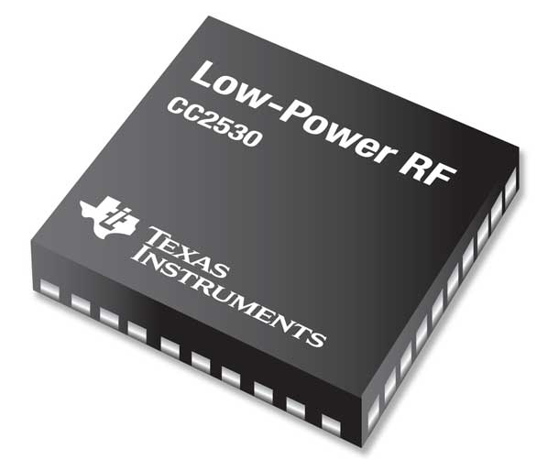
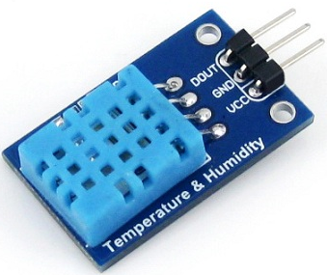
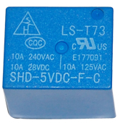
Node Design - Hardware
CC2530 has an advantage of power consumption.
Use DS18B20 or DHT11 as Sensors.
Battery supplies power for the whole node.
Relay can turn on or off some devices. It plays a role as a switch.
ANIMATIONS
15%
AWESOME WORK
⬧

Slide 8

Node Design - Software
The node uses Contiki as its runtime environment.
Open source, great portability …
uip6 network protocol stack, 6LoWPAN WSN protocol stack, COAP, MQTT application.
We choose COAP as the application of these nodes.
ANIMATIONS
15%
AWESOME WORK
⬧

Slide 9
COAP Protocol
Constrained Application Protocol
Based on UDP and REST structure
Size of the minimum data packet: 4 bytes
Method: GET, POST, PUT and DELETE
Similar with HTTP
ANIMATIONS
15%
AWESOME WORK
COAP vs. HTTP
⬧
coap://machine.address:5683/sensors/temperature
URL example

Slide 10
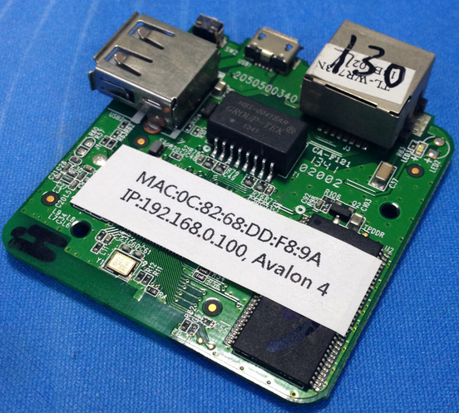
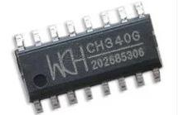
Border Router Design
Border Router uses openWRT which is a special embedded linux system.
CC2530 uses its uart to communicate with openWRT system.
The protocol between CC2530 and openWRT is SLIP.
SLIP is a simple Internet protocol that is based on serial line.
ANIMATIONS
15%
AWESOME WORK
⬧

Slide 11
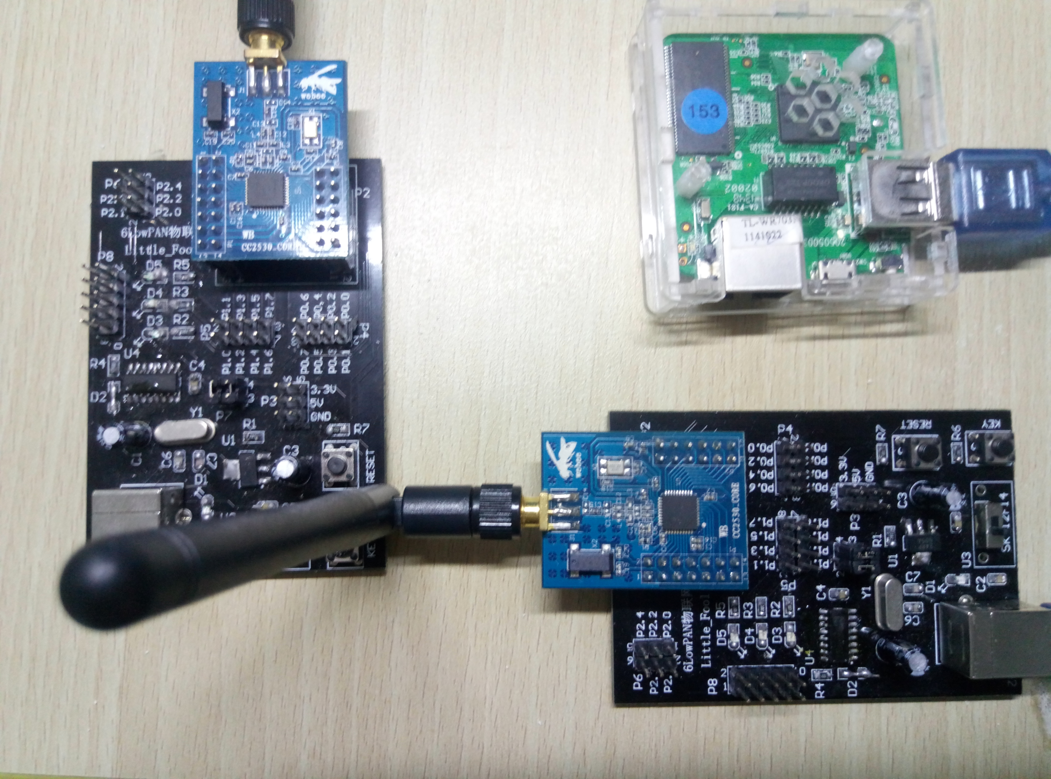
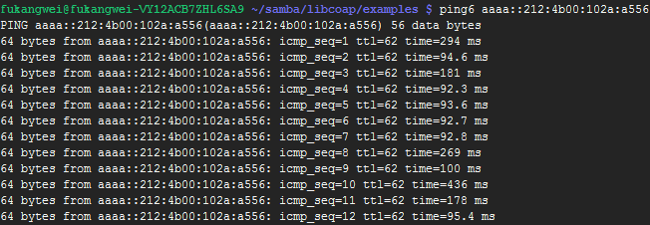
System Testing
Border Router: openWRT and CC2530, connected by serial port line.
The node is set as a coap server.
Use command “ping” to test whether the node was connected with the Internet.
Node on the left, Border router on the right
⬧
The “ping” test

Slide 12
System Testing
Use libcoap as the client of the coap server.
“-m get” makes libcoap use GET method to send requests to the coap server.
The function of the coap server is response the simple string for what you request.
coap server test
⬧

Slide 13
THANK YOU

